Slide 1
Diphyllobothrium latum
Dr. Bindhusaran
Assistant Professor
Department of Pathology & Microbiology

Slide 2
Diphyllobothrium latum
Common Names: The fish tapeworm; the broad tapeworm.

Slide 3
Habitat
Adult worm lives in the small intestine
Geographical Distribution. Central Europe, America, Japan and Central Africa. It has not yet been reported from

Slide 4
Morphology
The adult worm is yellowish-grey in colour with dark central markings caused by the egg-filled uterus.
It measures 3 to 10 metres in length.
The individual worm may live for a period of 5 to 13 years

Slide 5
The scolex (“head”): is elongated and spoon-shaped and measures 2 to 3 mm in length by 1 mm in breadth.
It bears two slit-like grooves (bothria) situated on the dorsal and ventral surfaces respectively.
There are no rostellum and no hooks
The “neck” is thin and unsegmented and is much longer than the “head”.

Slide 7
proglottides (Segments).
These are 3,000 to 4,000 in number.
The segments are greater in breadth than in length. A mature segment measures 2 to 4 mm in length by 10 to 20 mm in breadth and is practically filled with male and female reproductive organs.
The terminal segments are apt to be shrunken and discharge of eggs through the uterine pore.
Later the dried-up segments break off from the body, not singly but in chains.

Slide 9
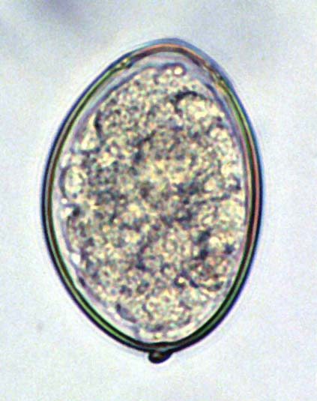
Egg
Oval and brown
Contain yolk granules and un segmented ovum
There is an operculum at one end and a knob at lower end

Slide 10
Larva
1st stage: coracidium
2nd stage: procercoid
3rd stage: plerocercoid

Slide 11
Life Cycle
Compeleted in one definitive host and two intermediate hosts.
Definitive Hosts: Man, dog and cat; man is the optimum host. The adult worms are found in the small intestine.
Intermediate Hosts. Aquatic animals, where the larval stages are passed:
(i) The FlRST INTERMEDIATE HOST is a fresh-water crustacean, a cyclops or a diaptomus.
(ii) The SECOND INTERMEDIATE HOST is a fresh-water fish, pike, trout, salmon, perch and other fish.

Slide 14
DEVELOPMENT OF EGG IN WATER AND LIBERATION OF A CORACIDIUM
The operculated eggs are liberated through the faeces of definitive hosts in water.
A spherical ciliated embryo containing 3 pairs of hooklets, called coracidium. develops within each egg-shell in the course of 1 to 2 weeks.
The mature coracidium (40 to 55 um in diameter) escapes into the water and is ingested by cyclops.

Slide 15
LARVAL DEVELOPMENT INSIDE FISH
. In the intestine of fish, the procercoid larva (550 mm in length) after freeing itself, passes through the gut-wall and rests into the liver, muscles or voluminous fat.
In 1 to 3 weeks, the procercoid larva changes into a “sgarganum” or plerocercoid larva.
The body of the larva is white, somewhat flattened and marked by irregular unsegmented wrinkles.

Slide 16
INFECTION OF MAN AND DEVELOPMENT OF ADULT WORM.
The plerocercoid larva is infective to man.
It is not destroyed by ordinary salting, pickling or smoking and therefore with the eating Of these insufficiently cooked fish or raw one man is infected.
Inside the intestine of man, the plerocercoid larva develops into an adult worm and after having attained sexual maturity in about 5 to 6 weeks, starts discharging eggs which are passed along with the faeces.
The cycle is thus repeated.

Slide 17
Pathogenicity
Mode of infection: By ingestion of imperfectly cooked infected fish or roe containing plerocercoid larvae
Infection is called diphyllobothriasis
Clinical features
Gastrointestinal disturbances and
Anemia( addisonian)
Early eosinophilia

Slide 23
Diagnosis
Stool examination and identification of operculated egg

Slide 24
Common Names: The dog tapeworm; the hydatid Worm
Geographical Distribution. Although the hydatid disease is worldawide in distribution, it is most commonly found in those countries where sheep and cattle-raising constitutes an important industry and consequently, there is a close association between man, sheep and dog. It is more a disease of temperate climates than of tropical areas.

Slide 25
Habitat.
Man harbours the larval form and not the adult worm which IS however found 1n the small intestine of dog and other canine animals.

Slide 26
Morphology
ADULT WORM . It is a small tapeworm, measuring 3 to 6 mm in length. It comprises of a scolex (“head” , “neck” and strobila consisting of 3 segments (occasionally 4).
The first segment is immature, the second one is mature and the last one (as well as the fourth one, when present) is gravid.
The terminal segment is by far the biggest, measuring 2 to 3 mm in length by 0.6 mm in breadth.

Slide 27
The scolex bears four suckers and a protrusible rostellum with two circular rows of hooks.
The “neck” is short and thick.

Slide 28
EGG.
It is ovoid in shape and resembles other eggs of Taenia. It measures 32 to 36 um in length by 25 to 32 mm in breadth and contains a hexacanth embryo with 3 pairs of hooks. The egg is infective to man, cattle, sheep and other herbivorous animals.

Slide 29
LARVAL FORM
This is found within the hydatid cyst developing inside the intermediate hosts.
It represents the structure of the scolex of the future adult worm and remains invaginated within a vesicular body.
On entering the definitive host, the scolex with four suckers and rostellar hooklets, becomes evaginated and develops into ( an adult worm.

